Slide 1



Agentic RAG
Chatbot 🤖
Agentic RAG Chatbot for Multi Document Q/A using Model Context Protocol

Slide 2
Agent Based Architecture with MCP
User Query
Retrieval Agent
This architecture uses Model Context Protocol.
The Agents pass messages from one Agent to another
Message Passing follows as shown in the architecture and every Message has Sender, Receiver, msg_type, trace_id and payload
LLM Response Agent
Final Response to User
Source Attribution Agent
Memory Agent

Slide 3
System Flow and Message Passing
USER
UI+Backend
MCP Based Context Manager
Interacts through a clean Gradio-based web UI.
Uploads multiple documents (PDF, DOCX, PPTX, etc.)
Asks queries in natural language related to the uploaded content.
Triggers the backend pipeline via a single click.
Built using Gradio
Files are passed to ingestion_agent for preprocessing.
Backend handles:
Input sanitization
File ingestion
Query-to-agent routing
Message Flow:
Retrieval Agent : Fetches top-k chunks
LLM Response Agent: Calls Ollama (LLaMA 3.2)
Source Attribution Agent: Tags references
Memory Agent: Produces final response

Slide 4
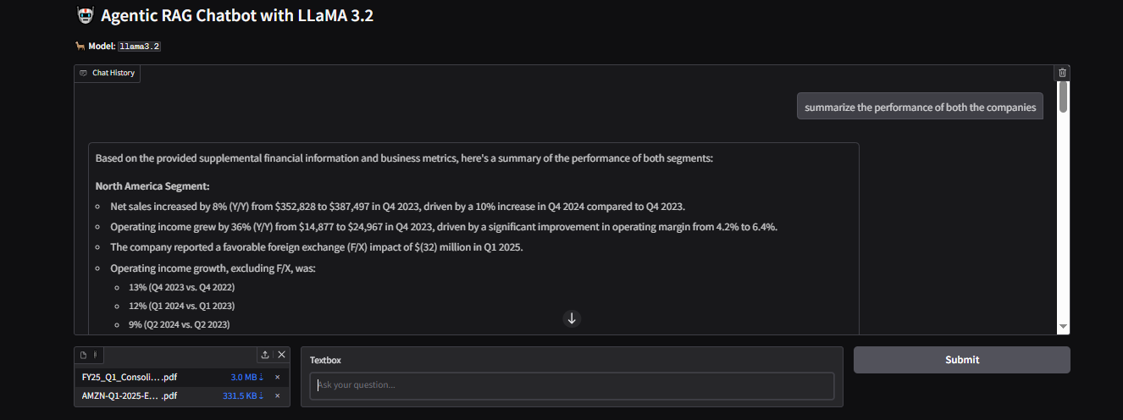
User Interface

Slide 5
Challenges Faced:
Incomplete LLM Response: The model I used, llama3.2 occasionally returned incomplete answers/responses. Resolved it by increasing num_predict and disabling stream
Slow Response Time: The model’s response time is very slow, due the large input contexts. Trying to enhance the response time

Slide 6
Future Scope and Improvements:
To further enhance the system’s flexibility and scalability, integration with LangChain or LangGraph can be explored. These frameworks provide structured agent orchestration, dynamic routing, and robust memory and tool handling. Using LangGraph can simplify the management of complex conversational workflows, allow parallel agent execution, and enable better traceability and error handling. It would also allow for seamless integration with external APIs, vector stores, and multi-modal models—making the system more powerful, modular, and production-ready.
Thank You

